Slide 1
Lab Exercise Incident Response
15 April 2026
Digit Oktavianto
https://threathunting.id

Slide 2
Analyzing DDOS Packet using Wireshark
Tools :
Wireshark :
Windows : https://1.na.dl.wireshark.org/win64/Wireshark-win64-3.4.9.exe
macOS : https://1.na.dl.wireshark.org/osx/Wireshark%203.4.9%20Intel%2064.dmg
Linux (Ubuntu) : apt install wireshark
Linux (redhat family) : yum install wireshark / dnf install wireshark
Pcap DDOS File Incident : https://drive.google.com/file/d/1JjlceCBngrVevZFlWT_9CEi9zb4jRxRR/view?usp=sharing
Some filter for detection

Slide 3
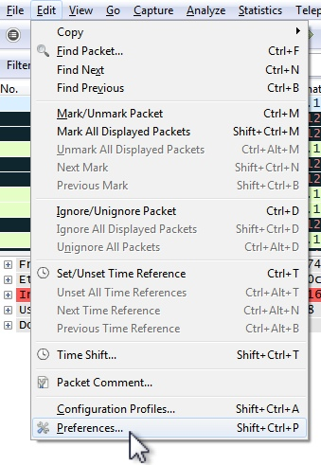
Wireshark Settings First!
Let's change this by editing our preferences ( edit --> Preferences ):

Slide 4
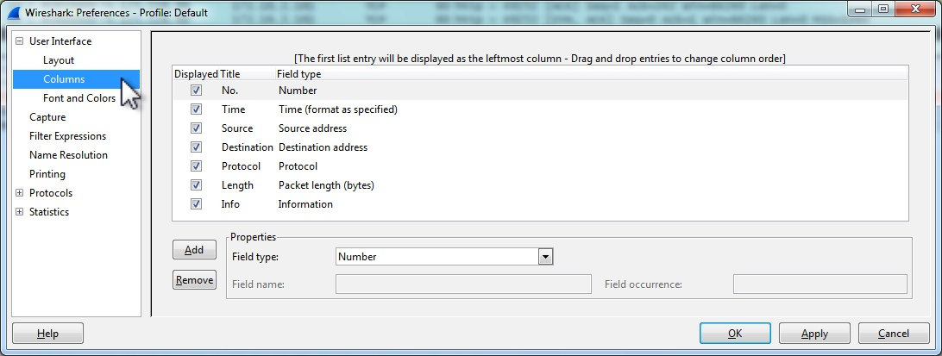
Wireshark Settings First!
From the Wireshark Preferences menu, select columns:

Slide 5
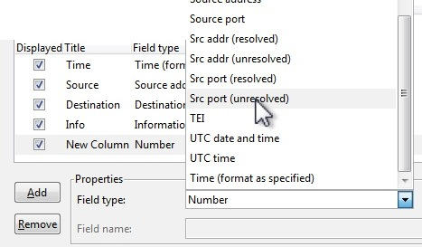
Wireshark Settings First!
The first new column to add is the source port. You'll want to select Src port (unresolved) so you can see the port number. Otherwise, it'll show whatever server is associated with that port instead of the number.

Slide 6
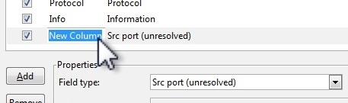
Wireshark Settings First!
The default name of any new columns is "New Column", so change the name of that new column.

Slide 7
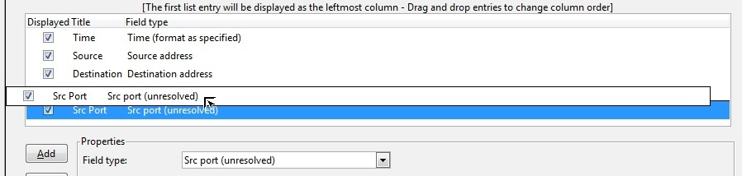
Wireshark Settings First!
Once you've changed the name, you can left-click and drag that column to the location you choose. We'll put it after the Source address.

Slide 8
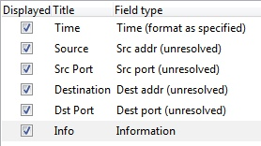
Wireshark Settings First!
After a few additions and column changes, here's the setup that I use. Notice how the Source and Destination addresses are changed to an "unresolved" field type.

Slide 9
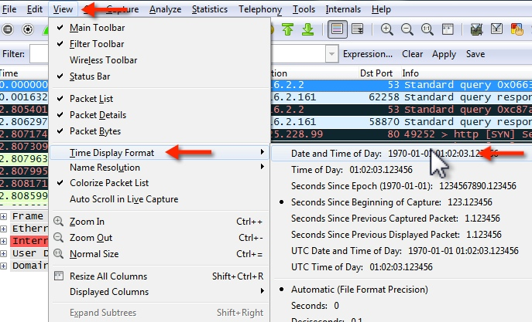
Wireshark Settings First!
Now let's fix the time. The default format is "Seconds Since Beginning Capture". Let's change it to "Date and Time of Day". Go to: View --> Time Display Format --> Date and Time of Day.

Slide 10
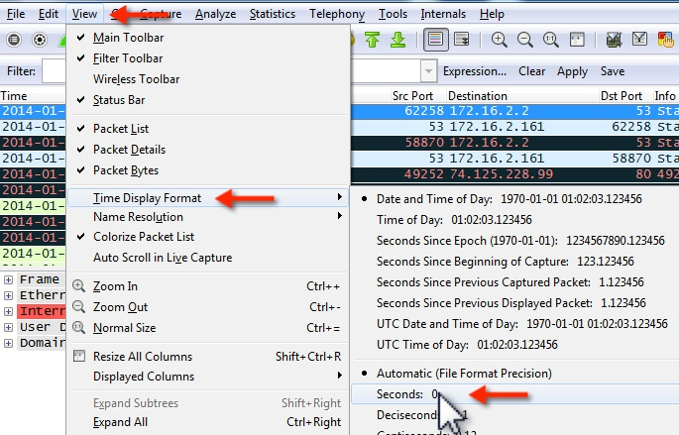
Wireshark Settings First!
After that, we'll change the precision of the displayed time from automatic to "Seconds", as shown below ( View --> Time Display Format --> select "Seconds: 0"):

Slide 11
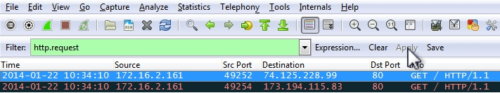
Wireshark Settings First!
Now we have everything, but I also want to see the http.host name as one of the columns. To do that, let's filter on http.request, so we're only seeing the HTTP requests.

Slide 12
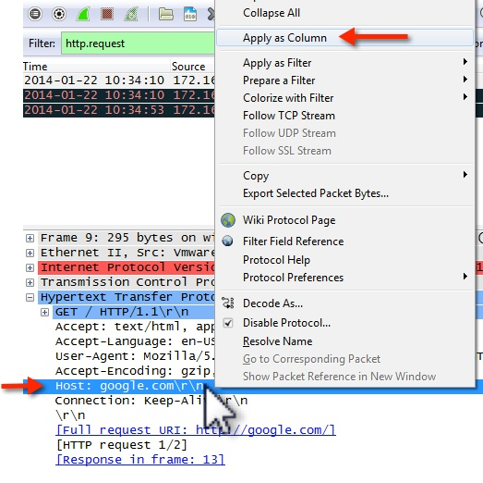
Wireshark Settings First!
Expand the breakout in the middle section, so you see the Host: line in the HTTP header. Right-click on that, and select "Apply as Column" from the menu.

Slide 13
Wireshark Settings First!
You'll notice now that the HTTP host from the GET or POST requests is now shown as a column. You might have to widen the column to see the whole name.

Slide 14
ACK-SYN Flood
An ACK-SYN flood is a DDoS attack designed to disrupt network activity by saturating bandwidth and resources on stateful devices in its path.
By continuously sending ACK-SYN packets towards a target, stateful defenses can go down (In some cases into a fail open mode). This flood could also be used as a smoke screen for more advanced attacks. This is true for other out of state floods too.

Slide 15
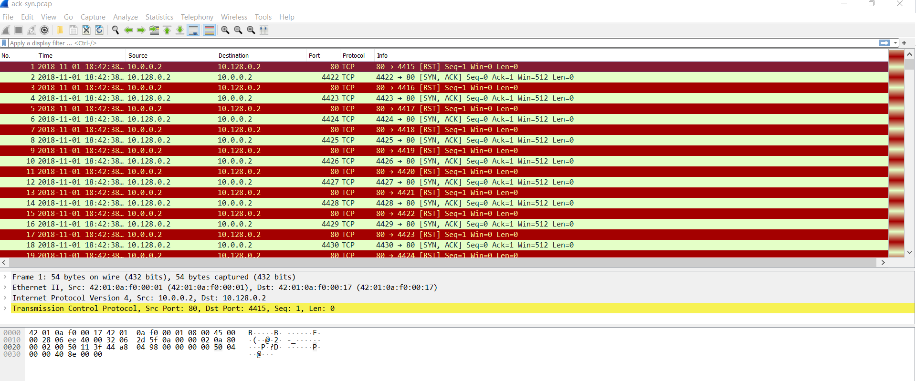
ACK-SYN Flood
Open Pcap files by clicking the pcap files or Open files in Wireshark by clicking File -> Open -> ack-syn.pcap files. If file opened, you can see the result looks like a picture down below.

Slide 16
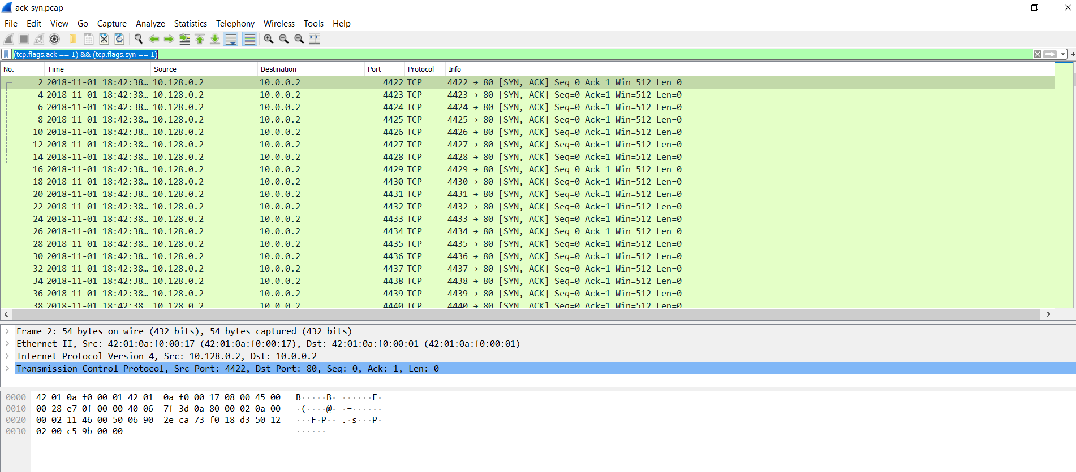
ACK-SYN Flood
Filter the packet by click filter from search box in text “current filter” and fill : (tcp.flags.ack == 1) && (tcp.flags.syn == 1) for filtering packet with ack and syn in DDOS packets incident and analyze it.

Slide 17
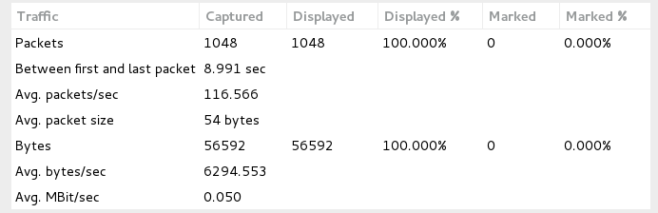
ACK-SYN Flood
You can check the rate of data by click Statistics -> Summary/Capture file properties.
A typical ACK-SYN flood running against an unsuspecting host will look similar to the above analysis. Generally what is seen is a high rate of ACK-SYN packets (not preceded by a TCP handshake) and a slightly lesser rate of RST packets coming from the targeted server.

Slide 18
HTTP Flood
HTTP flood is a layer 7 DDoS attack that targets web servers and applications.
Layer 7 is the application layer of the OSI model. The HTTP protocol – is an Internet protocol which is the basis of browser-based Internet requests, and is commonly used to send form contents over the Internet or to load web pages.
HTTP floods are designed to overwhelm web servers’ resources by continuously requesting single or multiple URL’s from many source attacking machines, which simulate a HTTP clients, such as web browsers (Though the attack analyzed here, does not use browser emulation).
An HTTP Flood may consist of either GET (images and scripts), POST (files and forms) or combined GET and POST requests. There are also more exotic attacks which may utilize other HTTP methods such as PUT, DELETE etc.
When the servers’ limits of concurrent connections are reached, the server can no longer respond to legitimate requests from other clients attempting to connect, causing a denial of service.
HTTP flood attacks use standard URL requests, hence it may be quite challenging to differentiate from valid traffic. Traditional rate-based volumetric detection, is ineffective in detecting HTTP flood attacks, since traffic volume in HTTP floods is often under detection thresholds.

Slide 19
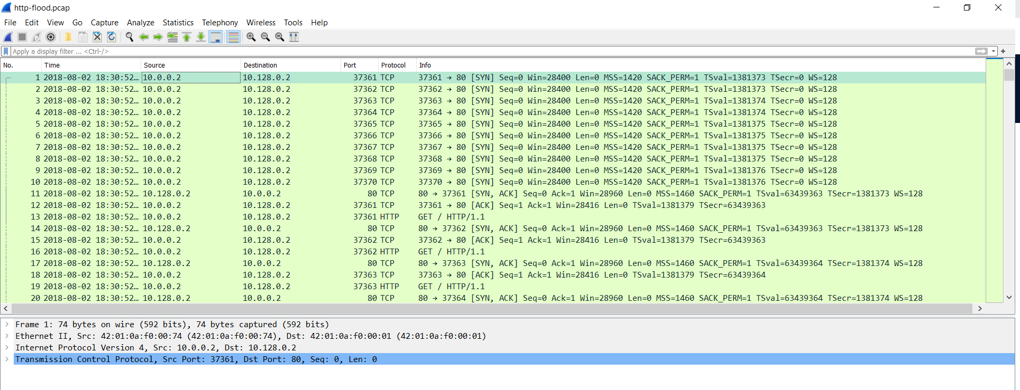
HTTP Flood
Open Pcap files by clicking the pcap files or Open files in Wireshark by clicking File -> Open -> http-flood.pcap files. If file opened, you can see the result looks like a picture down below.

Slide 20
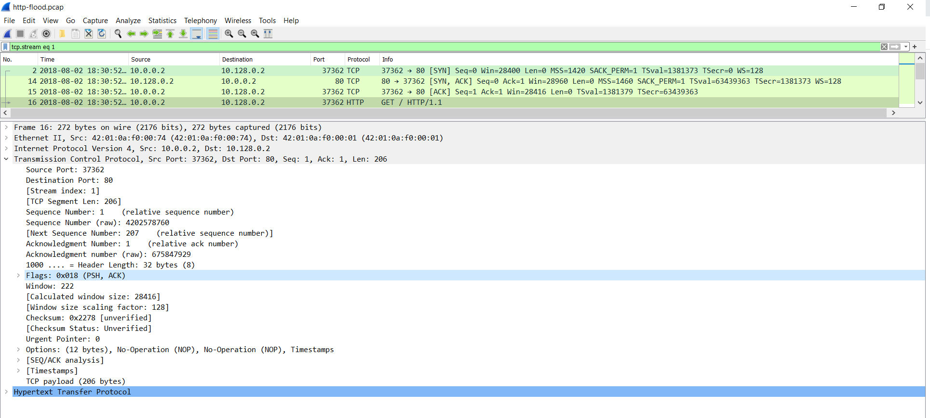
HTTP Flood
Before sending a HTTP request a TCP connection between a user agent and a server is established, using 3-Way Handshake (SYN, SYN-ACK, ACK) , seen in packets 2,14,15 in the example above. You can see and filter it from search box in text “current filter” and fill : ‘tcp.stream eq 1’ (to trace tcp stream 1st).
HTTP request packet will generally be in a PSH, ACK packet, as seen in packet 25 above.

Slide 21
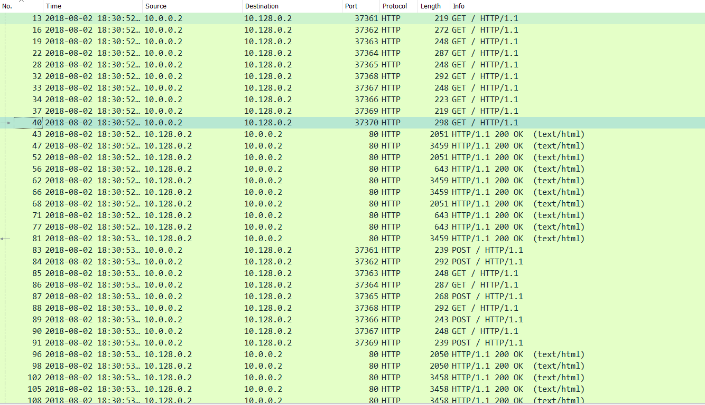
HTTP Flood
You can filter from filter from search box in text “current filter” and fill : “http” for showing all http related packets and you can filter specific function http from filter search box and fill : “http.request.method == GET” or “http.request.method == POST”. As you can see An attacker (Ip 10.0.0.2) sends many GET / HTTP / 1.1 and POST requests, while the target responds with HTTP/1.1 200 OK

Slide 22
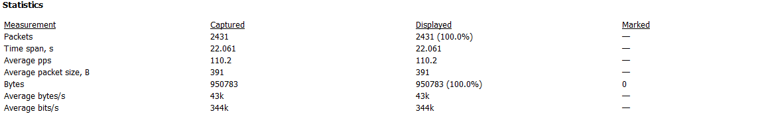
HTTP Flood
You can check the rate of data by click Statistics -> Summary/Capture file properties.
As seen in the image above. The capture analyzed is around 22.061 seconds and the average number of packets per second are around 110.2 PPS, with a rate of around 344000 bits per second or 0.344 Mbps.

Slide 23
UDP Flood
A UDP flood tries to saturate bandwidth in order to bring about a DoS state to the network.
This DDoS attack is normally done by sending a rapid succession of UDP datagrams with spoofed IPs to a server within the network via various different ports, forcing the server to respond with ICMP traffic. The saturation of bandwidth happens both on the ingress and the egress direction. This flood has some garbage in the data section of the datagram.

Slide 24
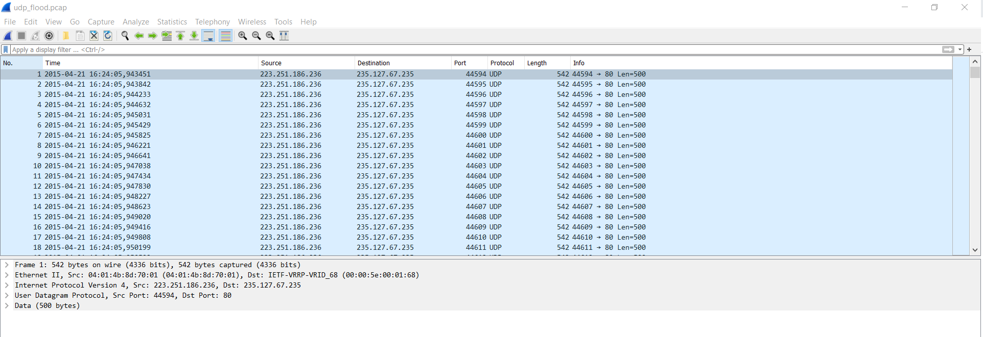
UDP Flood
Open Pcap files by clicking the pcap files or Open files in Wireshark by clicking File -> Open -> udp-flood.pcap files. If file opened, you can see the result looks like a picture down below.

Slide 25
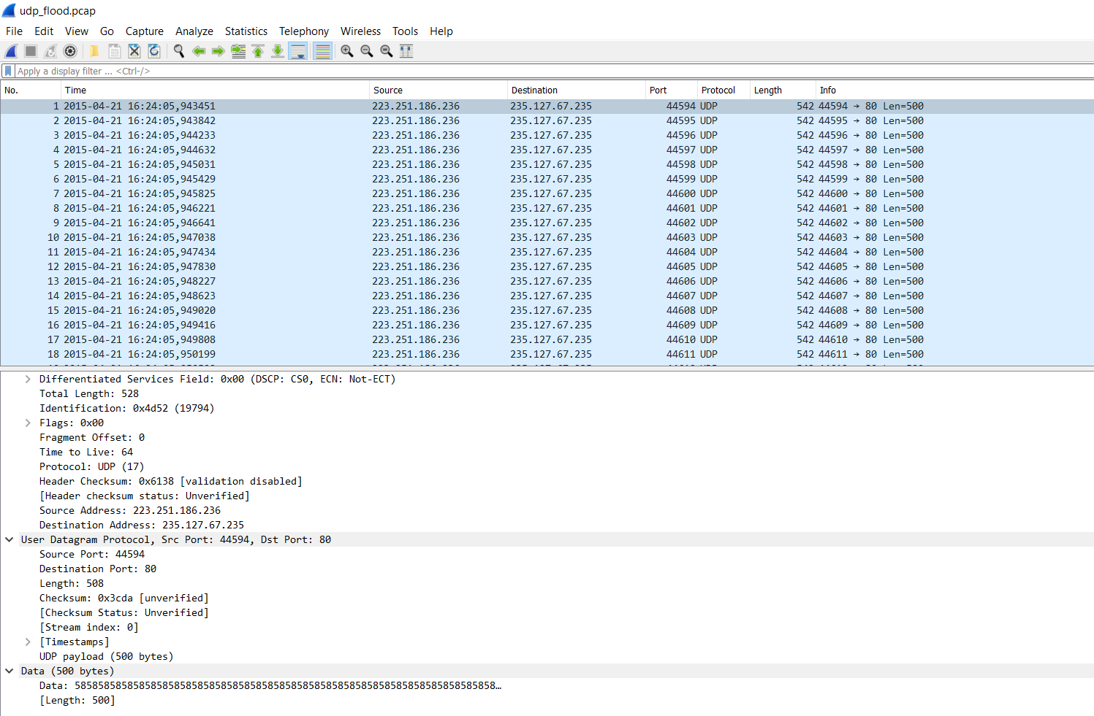
UDP Flood
Below is an analysis of a UDP flood running from a single SRC attacking IP at a high rate to a single destination target IP.
In Image below you can see the UDP packets being sent to port 80 of the destination target IP. This is highly unusual and in most cases UDP does not need to send to port 80 legitimately, These are the first signs of a UDP flood attack.

Slide 26
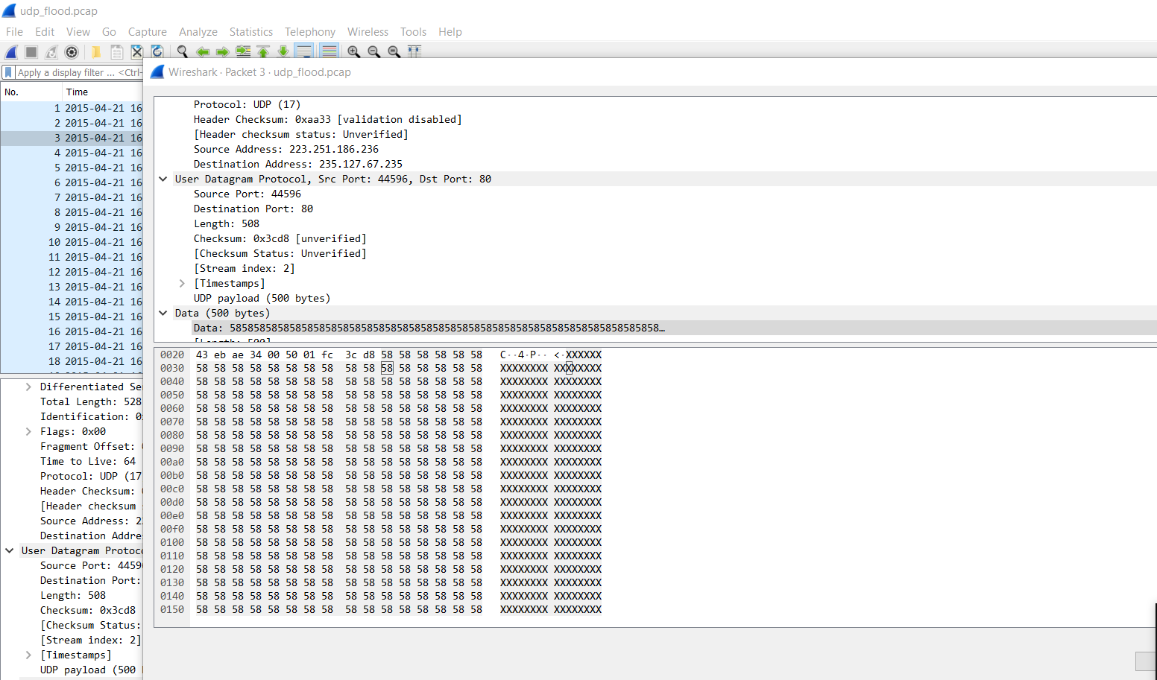
UDP Flood
As seen in Image below, in the data section of the packet, notice all the “XXXXXXXXXXXX” , 500 bytes of “garbage”, this is further evidence the packet is an attacking packet. Still targeting port 80.

Slide 27
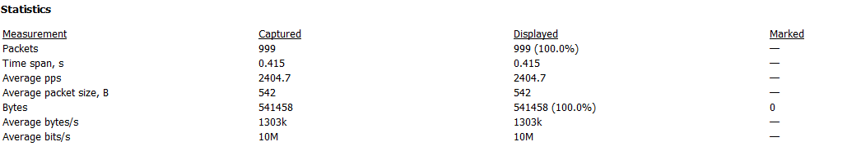
UDP Flood
You can filter the packet by click filter from search box in text “current filter” and fill : (ip.proto == 17) && (udp.dstport == 80) and you can see in summary image below over 2K PPS (Packets Per Second) is a strong indication that this is a UDP flood. a high rate of UDP packets with garbage data in them directed to port 80 at over 2K PPS. This is indicative of a UDP flood.
UDP Flood is a high volume flood due to the size of packets that can be generated per attacking machine. However identification of this type of flood is usually easier because of how easily this attack vector stands out in normal network communications.

Slide 28
Analyzing DDOS using BRIM
Brim is an open-source application that makes network packet analysis easier. And as per their GitHub repository, "Brim is an open source desktop application for security and network specialists. Brim makes it easy to search and analyze data from:
Packet captures, like those created by Wireshark, and
Structured logs, especially from the Zeek network analysis framework."
Brim uses ZQL query language to search and analyze the data. It is built using multiple different components, that include:
zq, a structured log query engine;
Electron and React for multi-platform user interfaces;
And Zeek, a network analysis framework.
Download :
Windows : https://github.com/brimdata/brim/releases/download/v0.26.0/Brim-Setup-0.26.0.exe
Linux :
Deb package : https://github.com/brimdata/brim/releases/download/v0.26.0/Brim-0.26.0.deb
Rpm package : https://github.com/brimdata/brim/releases/download/v0.26.0/Brim-0.26.0.rpm
MacOS : https://github.com/brimdata/brim/releases/download/v0.26.0/Brim-0.26.0.dmg

Slide 29
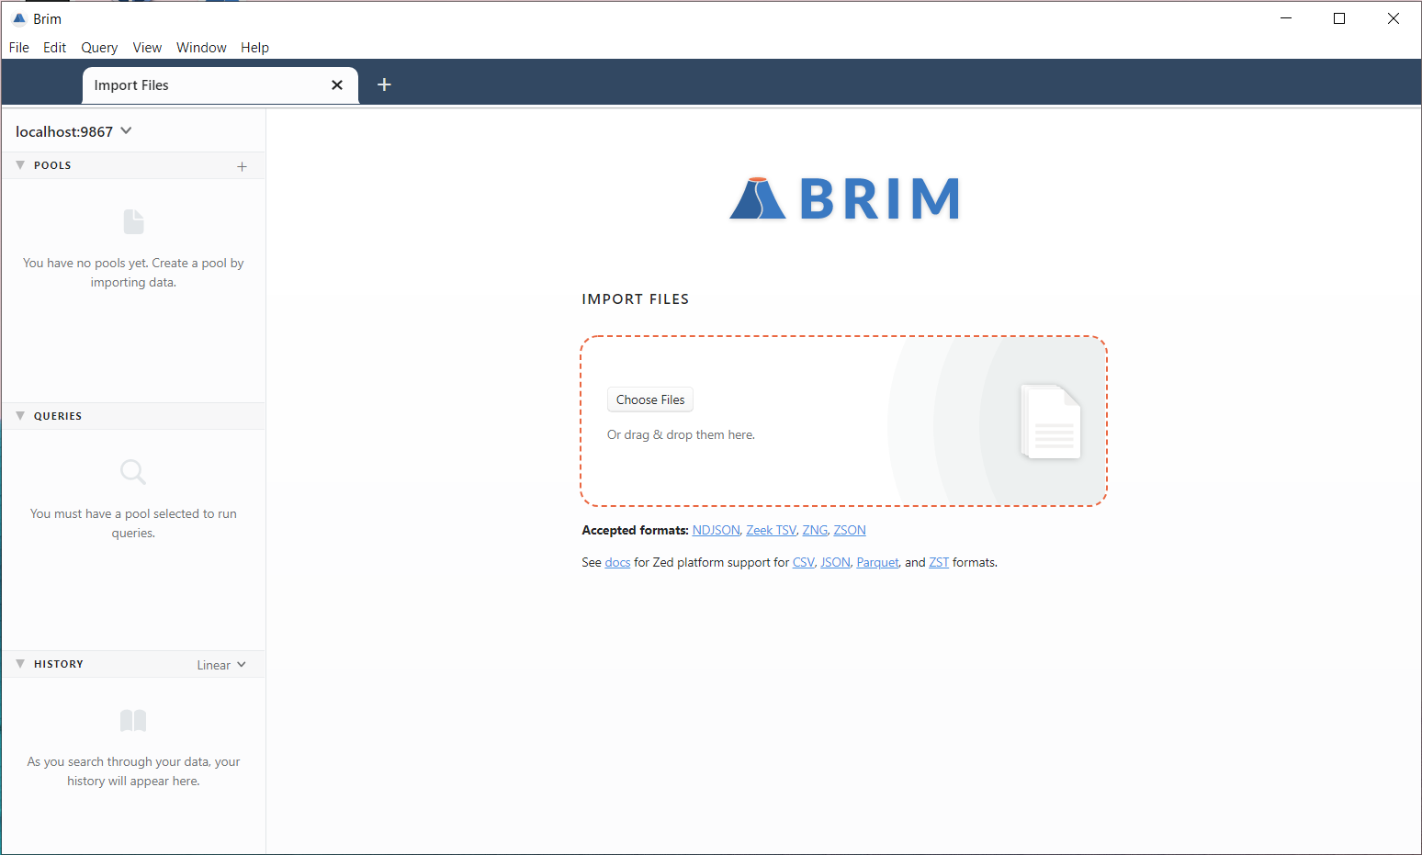
Analyzing DDOS using BRIM
If you successfully install the brim and open it, you will see menu like the image below.

Slide 30
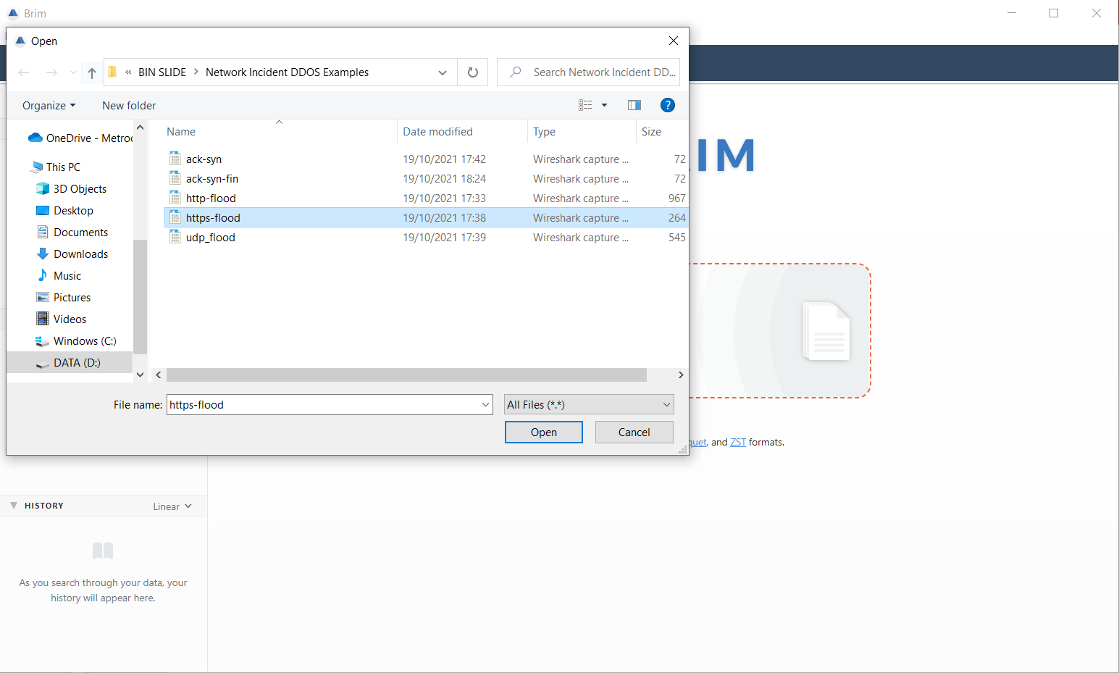
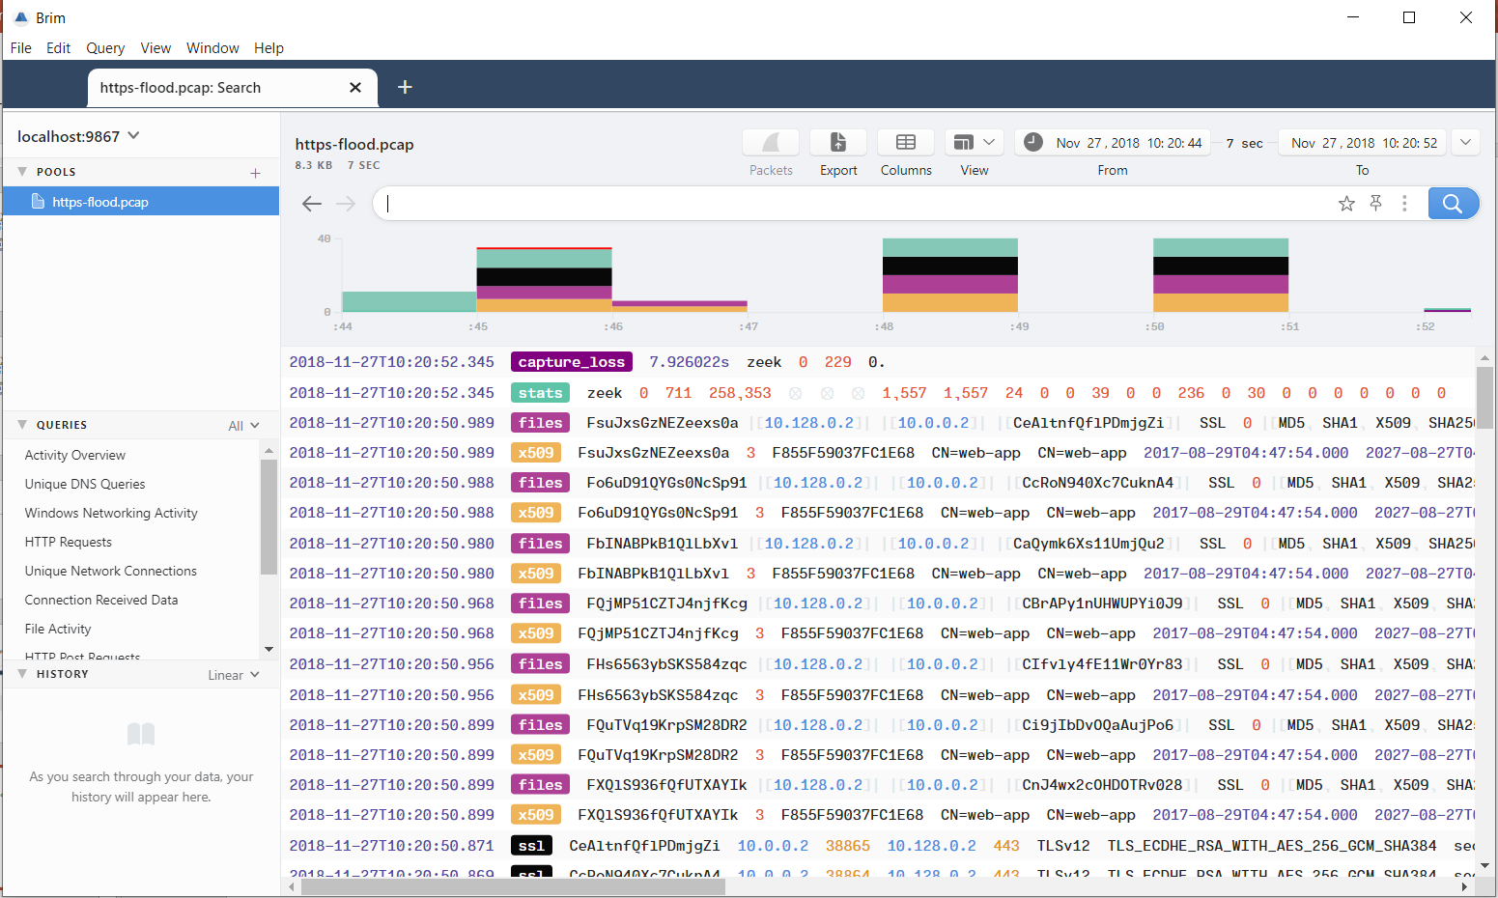
Analyzing DDOS using BRIM
We will analyze type DDOS of https (HTTPS flood attack), so choose pcap files with name https-flood.pcap to open it and if successfully opened, you can see the image in right side below.

Slide 31
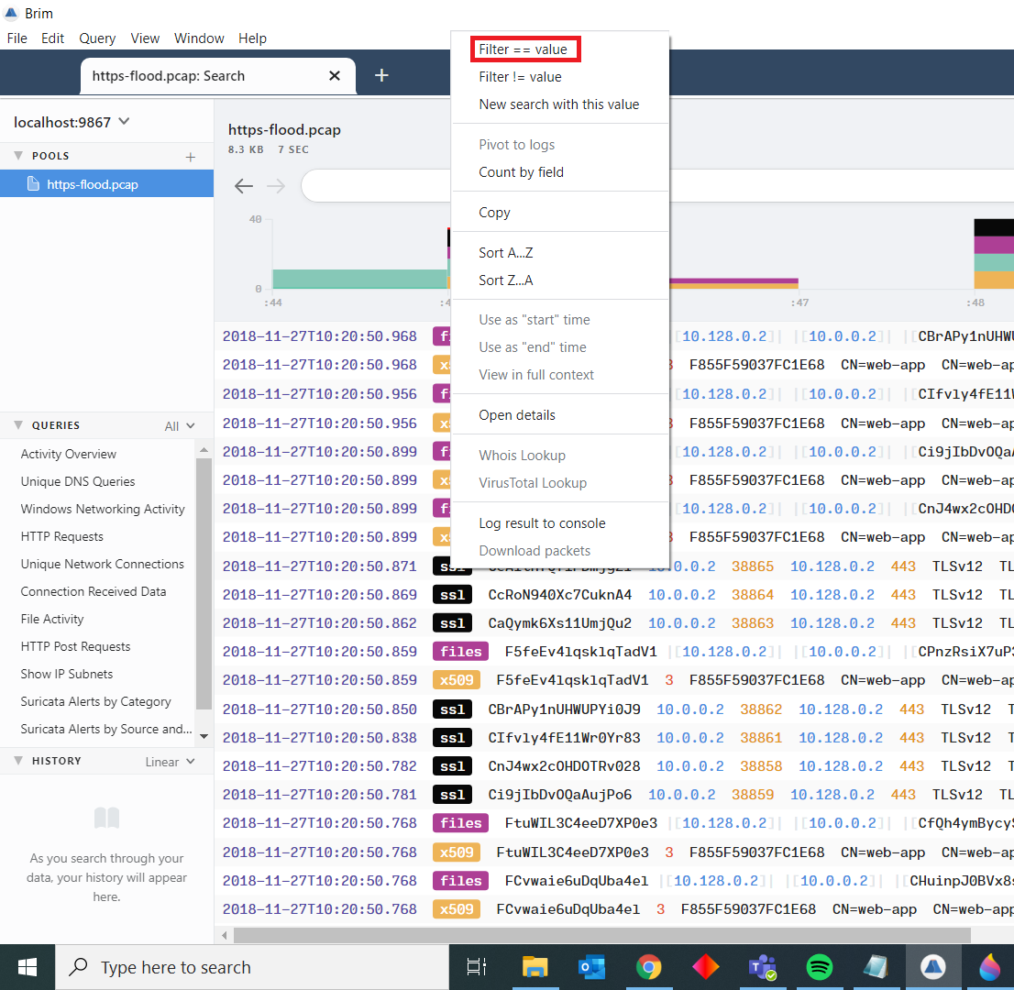
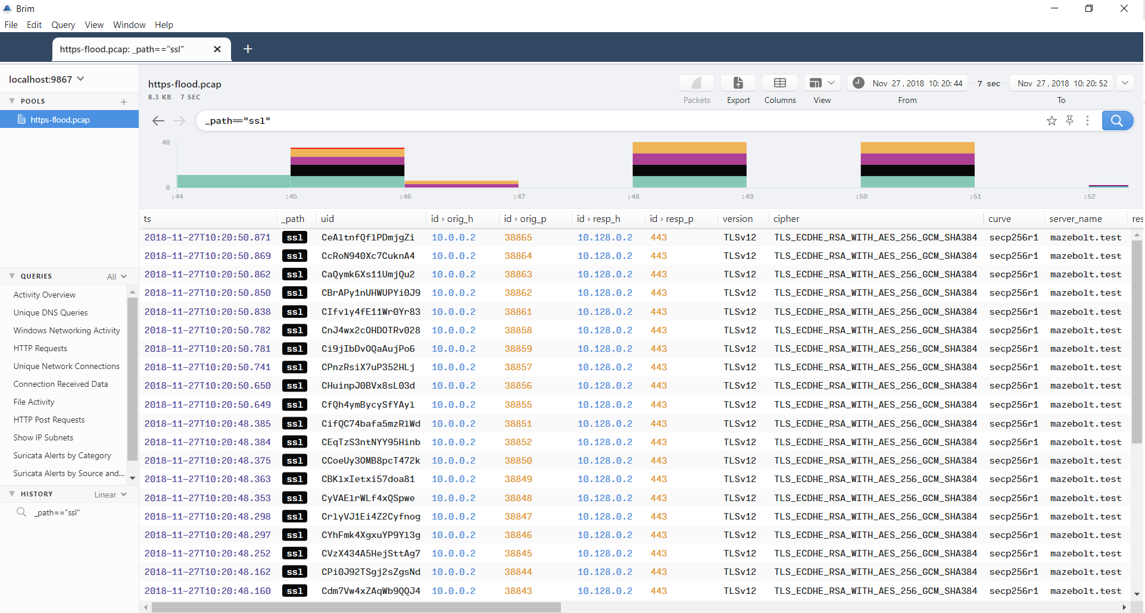
Analyzing DDOS using BRIM
If you want to select specific path/filter your data, you can select the path you want to specified and click right of your mouse and choose Filter==value. You can see the result from right sight image below.

Slide 32
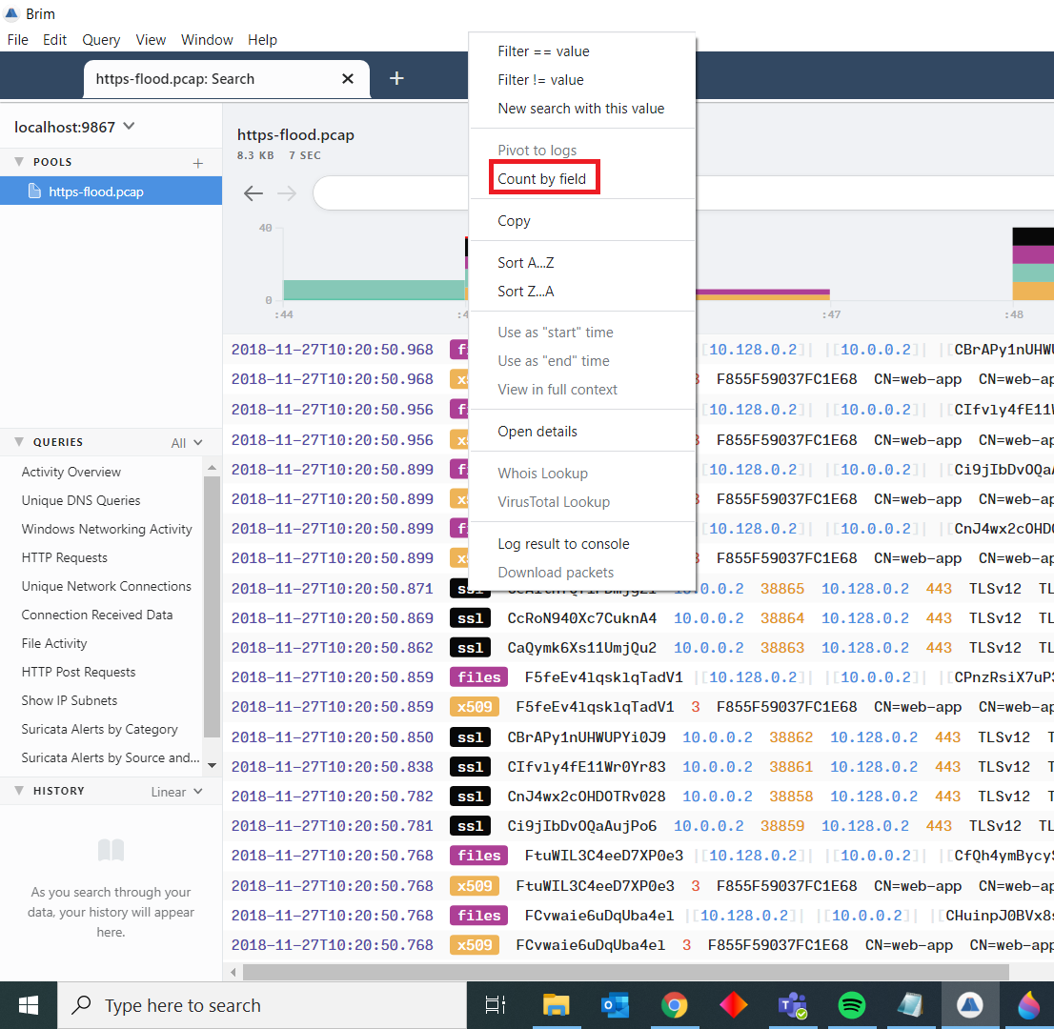
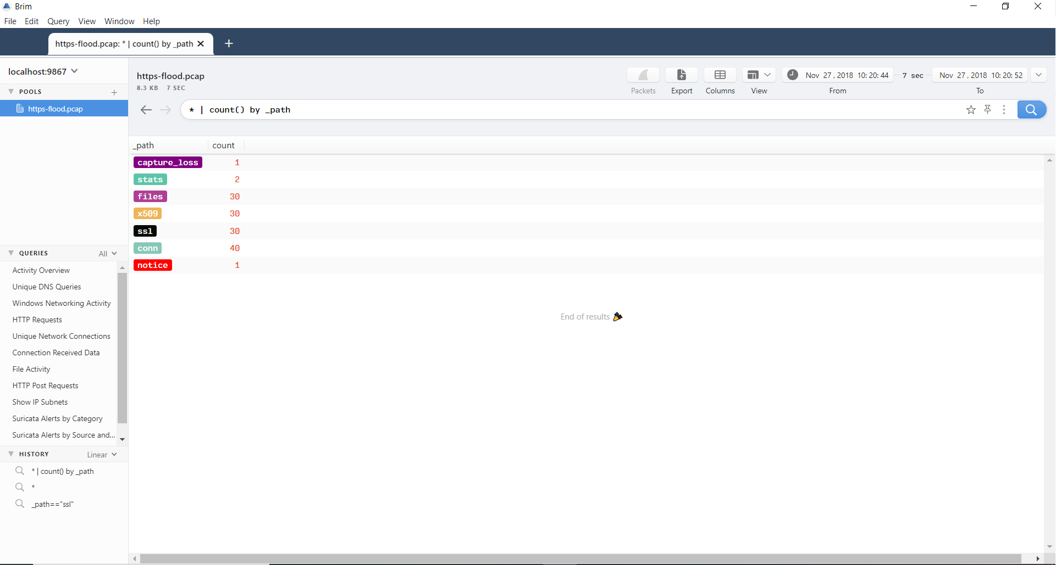
Analyzing DDOS using BRIM
If you want to counting the data from path, you can select the path and click right of your mouse and choose count by field, You can see the result from right sight image below.

Slide 33
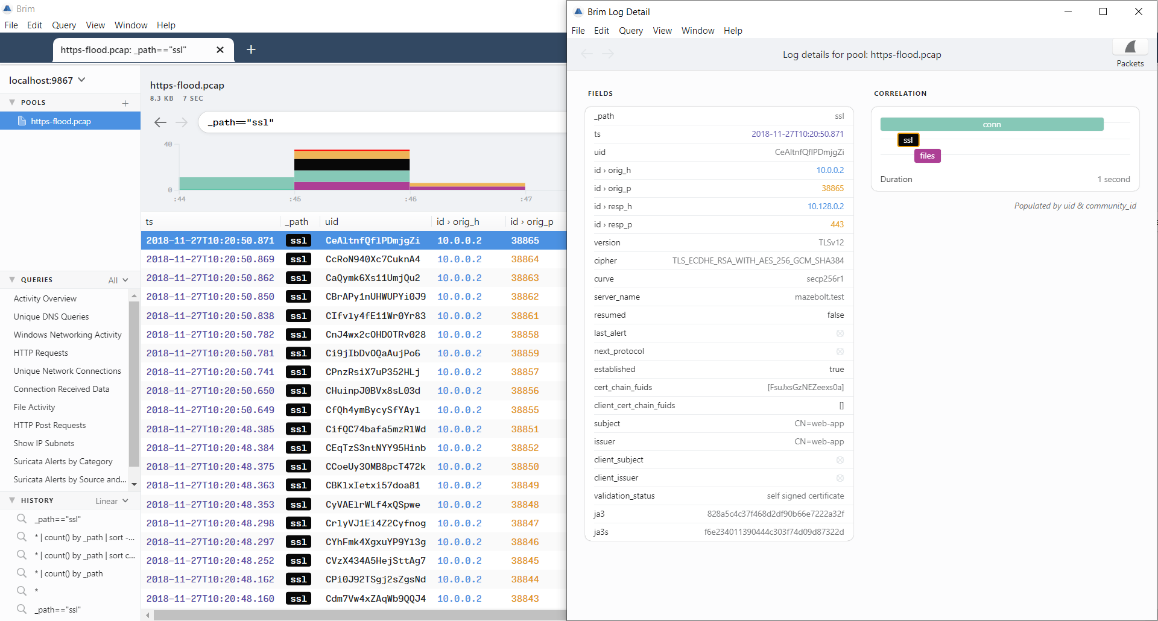
Analyzing DDOS using BRIM
If you want to see details of data, you can click the data in example ssl data and the you can see the menu of details of data

Slide 34
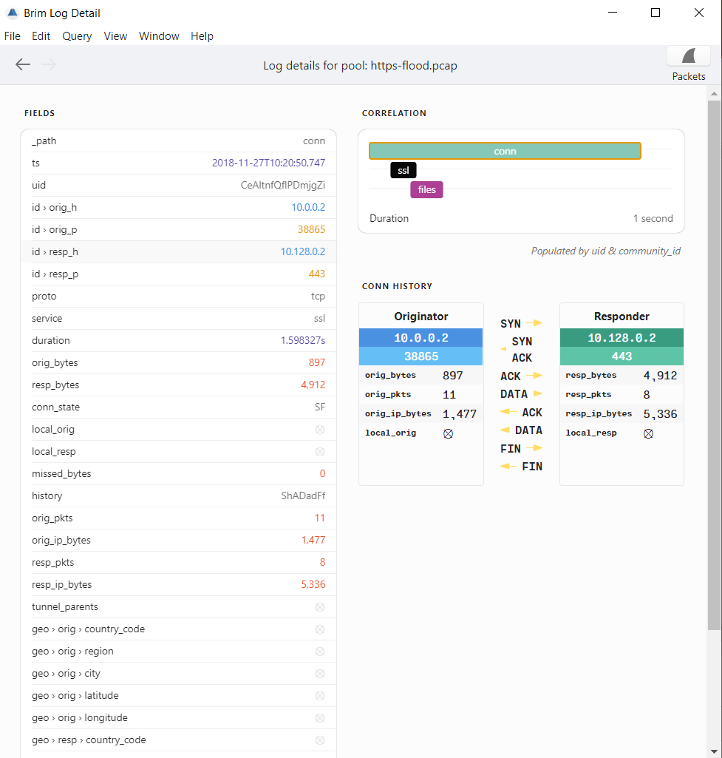
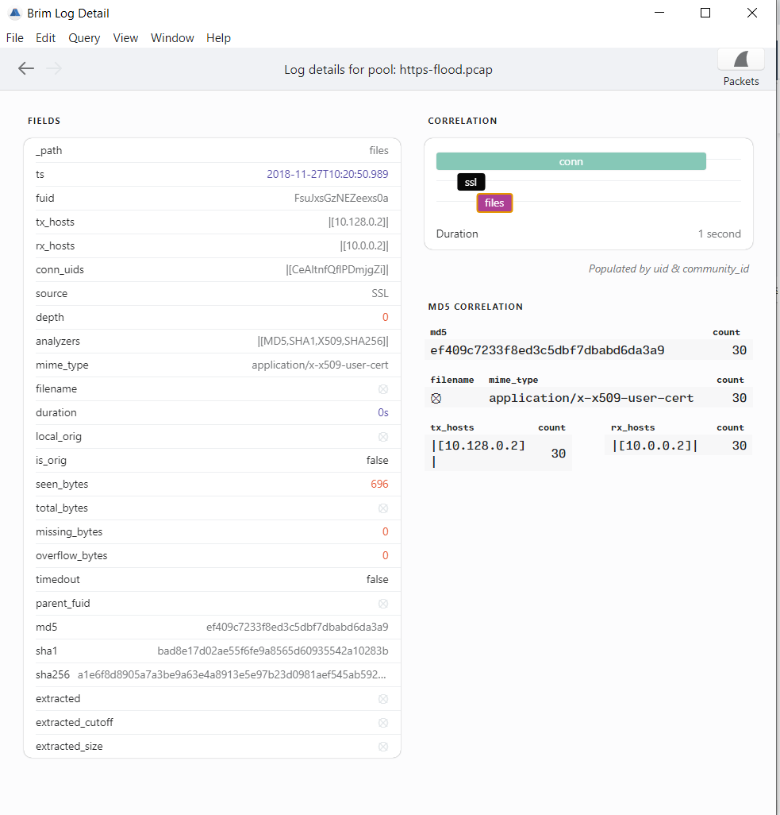
Analyzing DDOS using BRIM
You can check correlation of data too by clicking the correlation menu. Example we want to check correlation data in connection and files, just click the button conn and files you will see the results like the image below

Slide 35
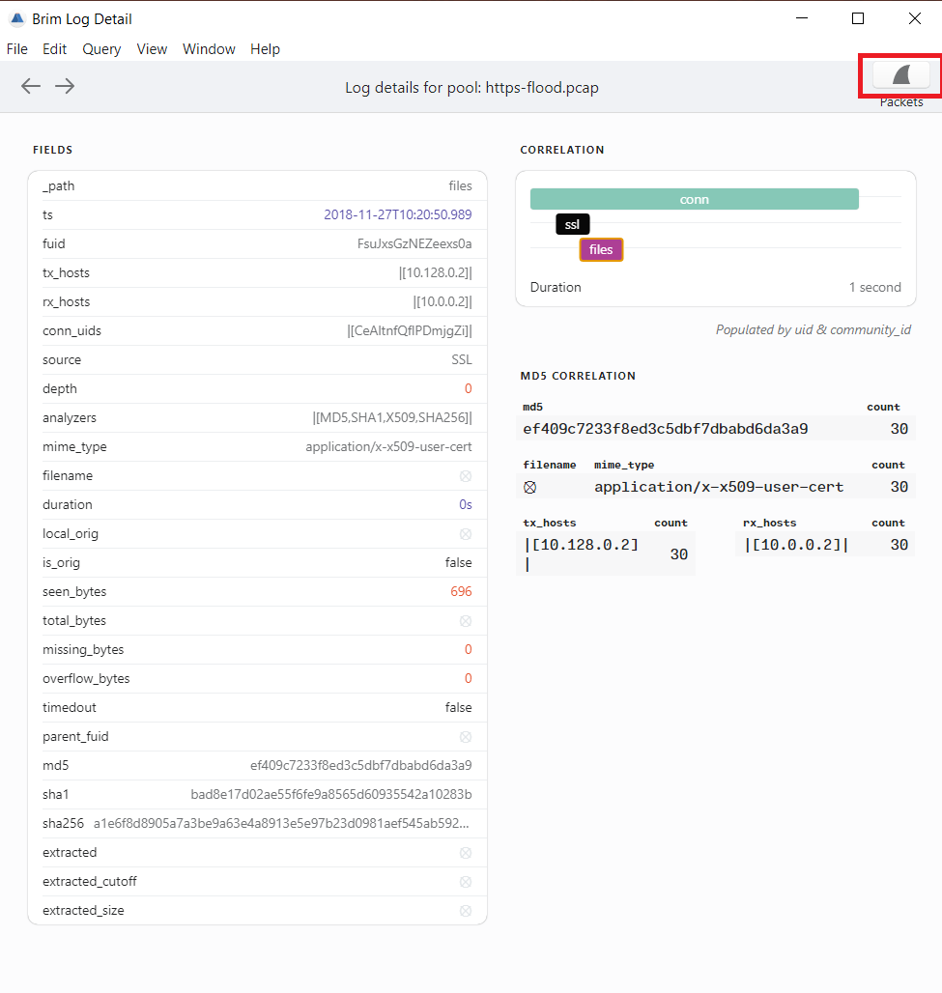
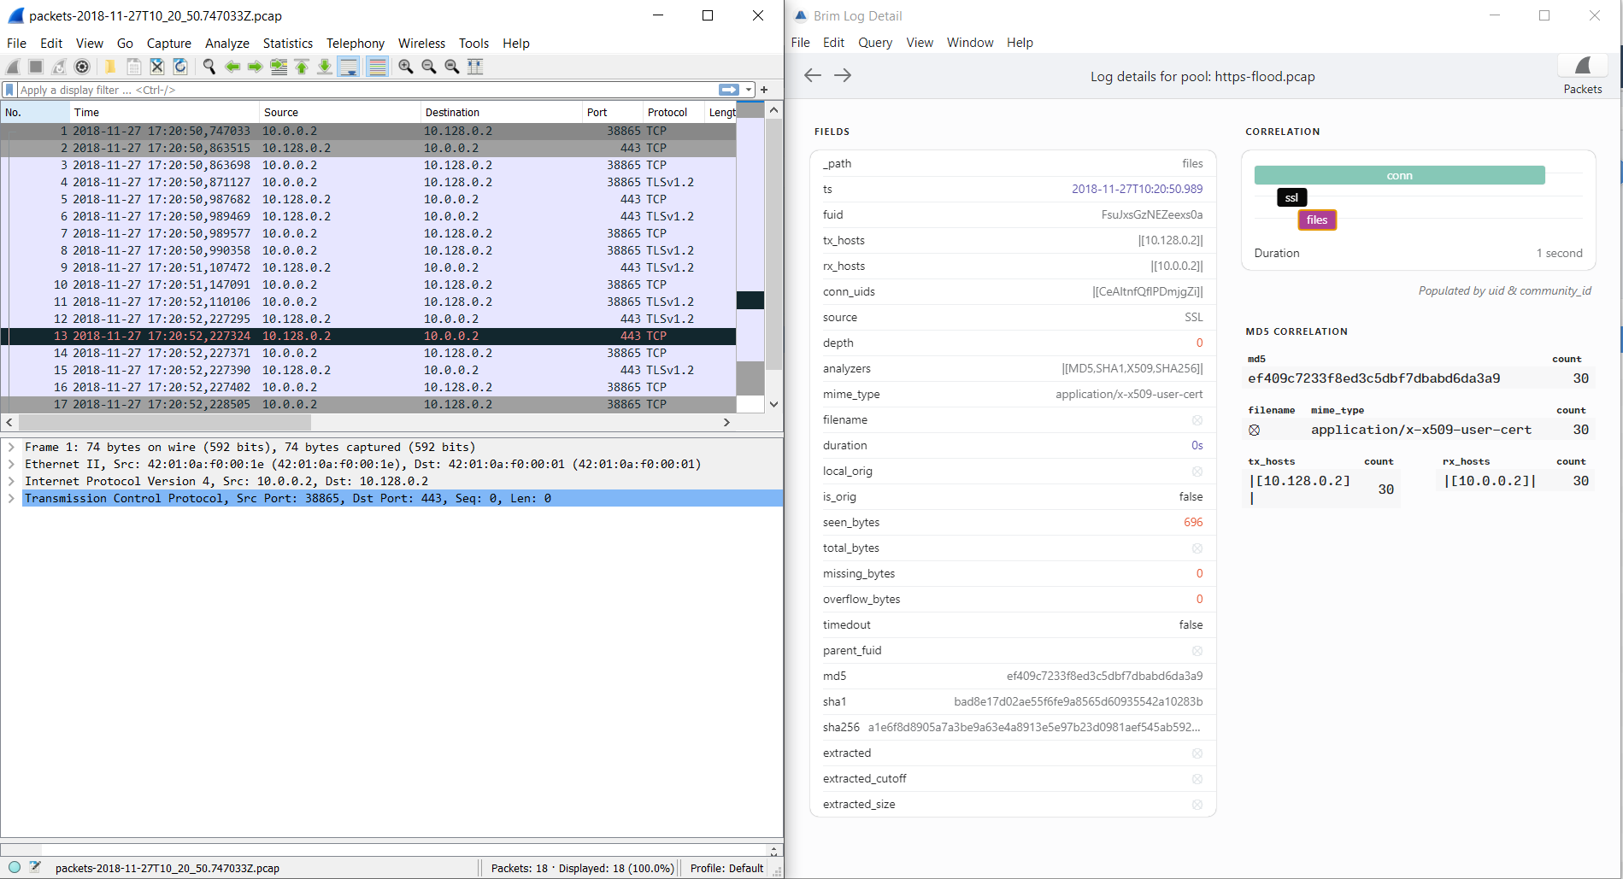
Analyzing DDOS using BRIM
Also the brim integrate by using wireshark, you can check the specific packet using wireshark by clicking logo in top of word packets.

Slide 36
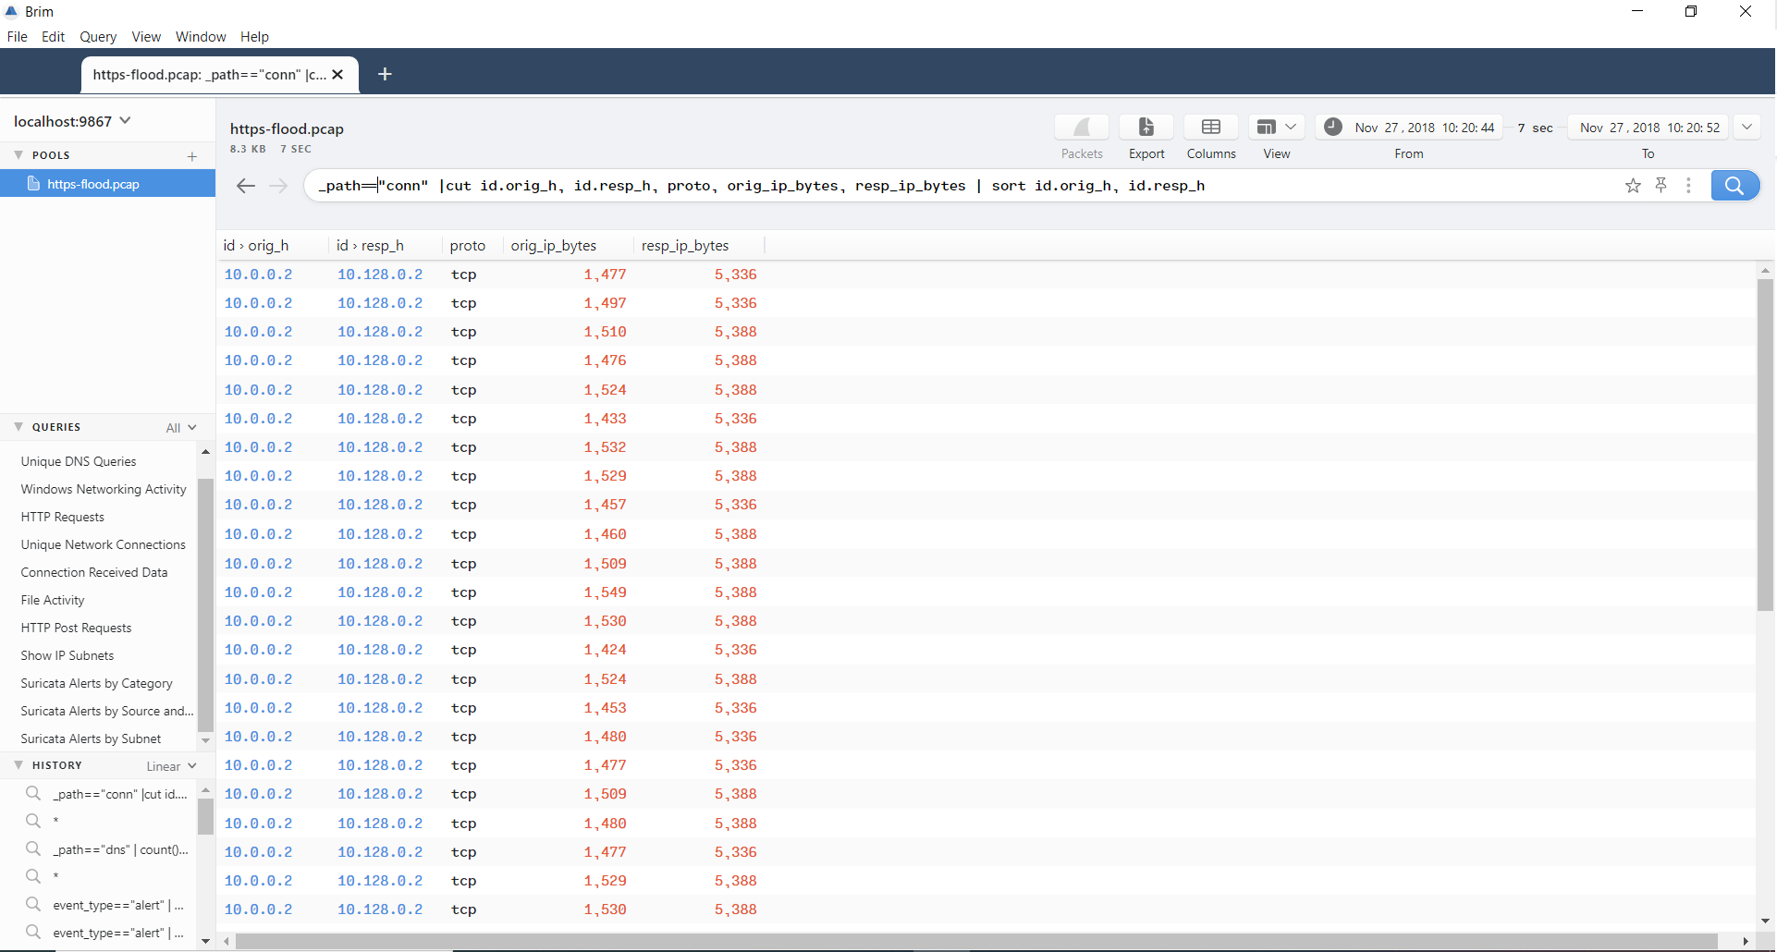
Analyzing DDOS using BRIM
You can check summary of the different connections. in the example below it only shows the source, destination, protocol, source sent bytes and receive bytes. And the result is sorted by source and destination. By Quering : _path=="conn" |cut id.orig_h, id.resp_h, proto, orig_ip_bytes, resp_ip_bytes | sort id.orig_h, id.resp_h

Slide 37
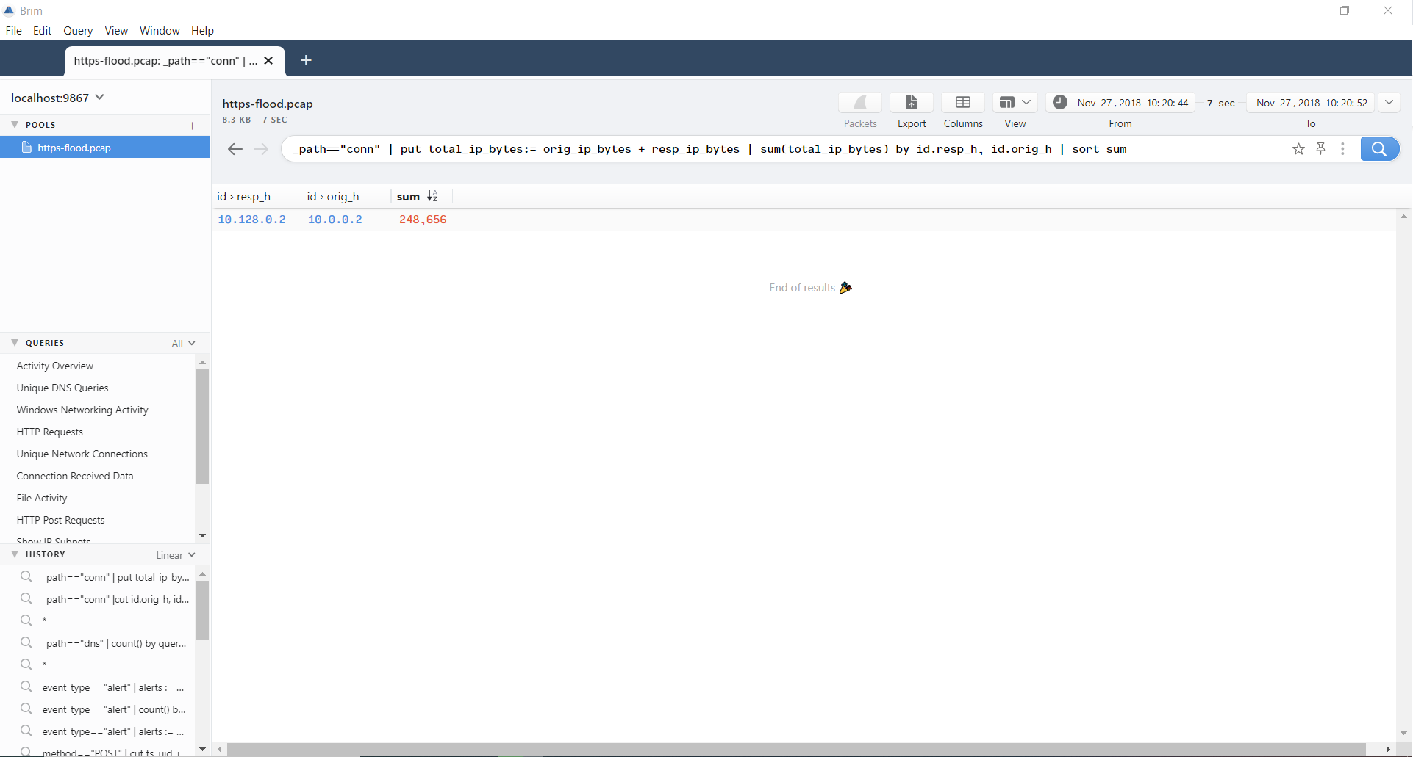
Analyzing DDOS using BRIM
You can check total bytes transferred per conversation too, using query : _path=="conn" | put total_ip_bytes:= orig_ip_bytes + resp_ip_bytes | sum(total_ip_bytes) by id.resp_h, id.orig_h | sort sum

Slide 38
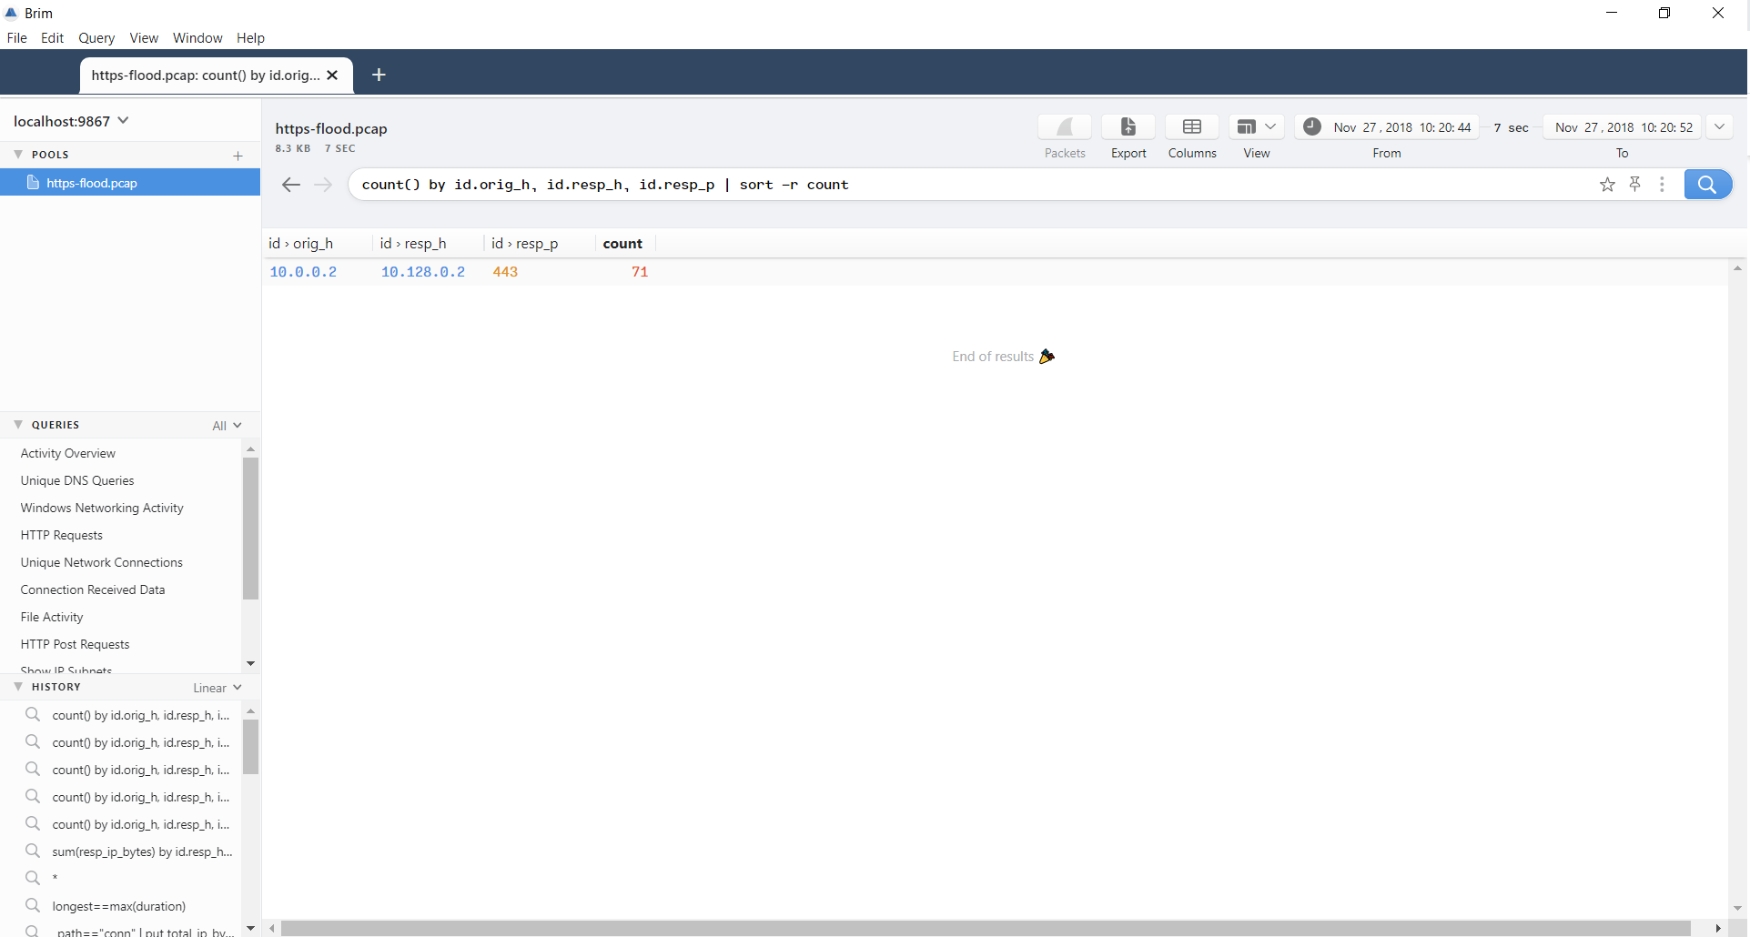
Analyzing DDOS using BRIM
You can count by destination port and source to check Return total count of events for each destination port that source was communication with destination. : count() by id.orig_h, id.resp_h, id.resp_p | sort -r count

Slide 39
Practical Lab : Linux DFIR Analysis

Slide 40
Linux Triage IR Tool

Slide 41
Unix-like Artifacts Collector </UAC>

Slide 42
UAC (Unix-like Artifacts Collector)
Runs on Android, AIX, ESXi, FreeBSD, Linux, macOS, NetBSD, NetScaler, OpenBSD and Solaris
Runs everywhere with no external dependencies
All UAC needs is shell ( /bin/sh )
Free and open source
Project page: github.com/tclahr/uac
Project documentation page: tclahr.github.io/uac-docs

Slide 43
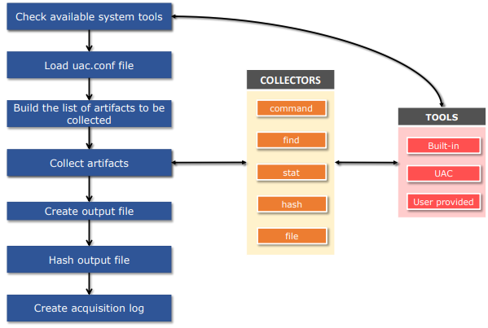
Behind the Scenes
How it works:
Execute tools UAC.
UAC program will be processing information related target Operating System.
UAC will be process to collect artifact from list.
Done. Enjoy your life☺

Slide 44
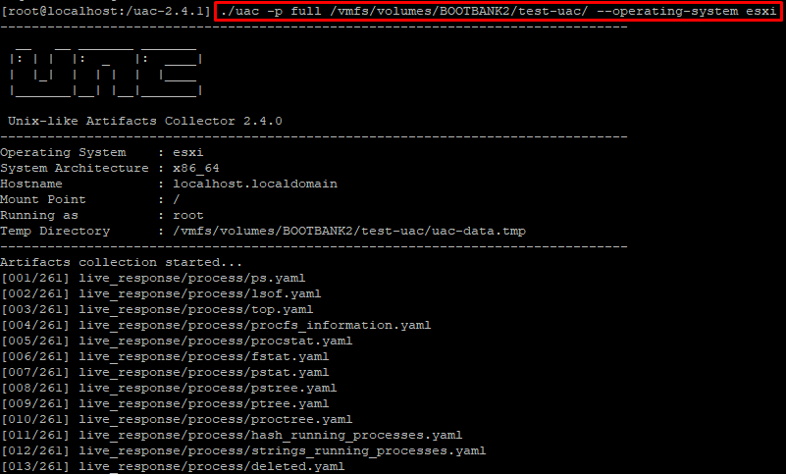
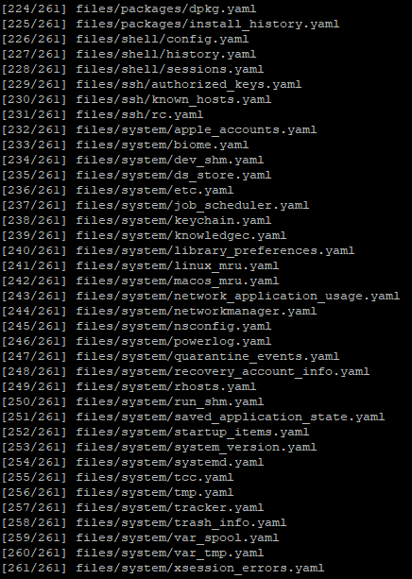
Running UAC ( Case on ESXi )
Play ./uac –p full /location-directory --operating-system esxi

Slide 45
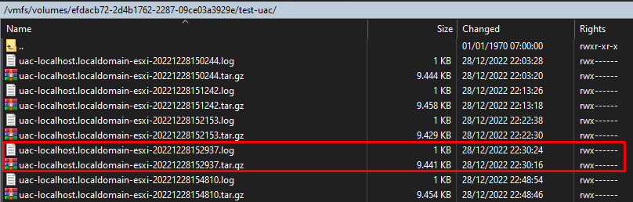
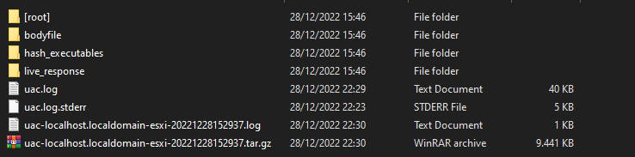
Artifact Collected

Slide 46
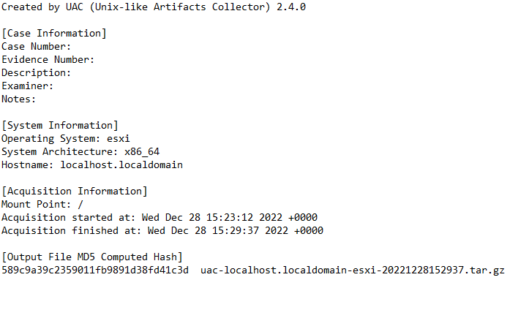
Acquisition Log

Slide 47
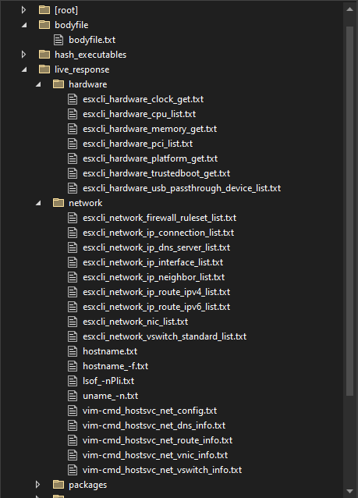
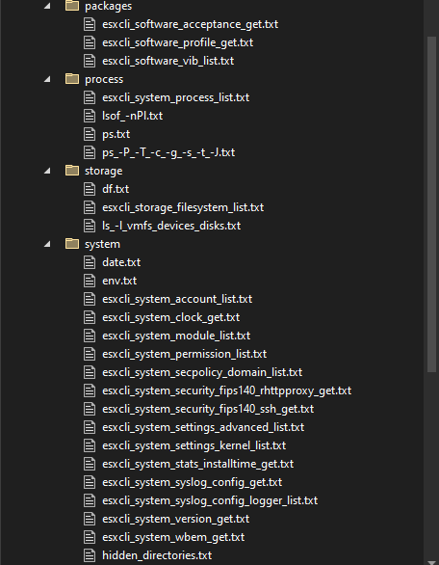
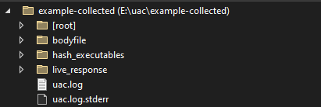
Output File

Slide 48
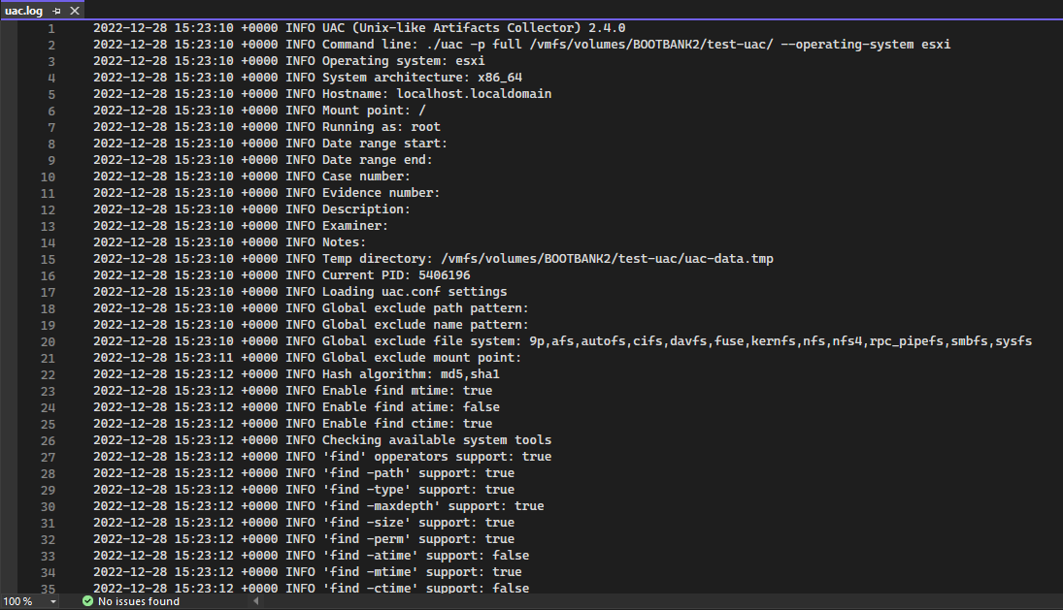
uac.log
Command line parameters
System information
Parsing artifacts

Slide 49
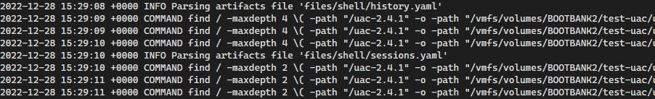
uac.log
Commands and parameters used during the collection

Slide 50

Let’s Investigating!

Slide 51
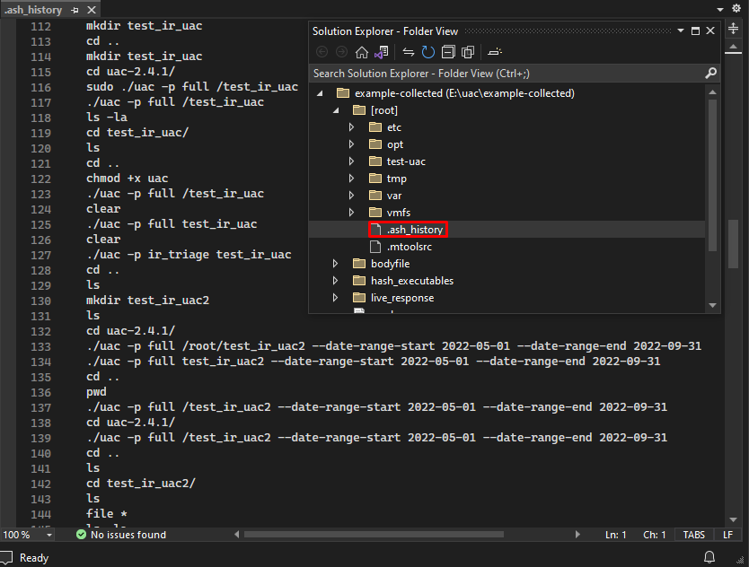
.ash_history
Same like bash history on linux
To see user activity

Slide 52
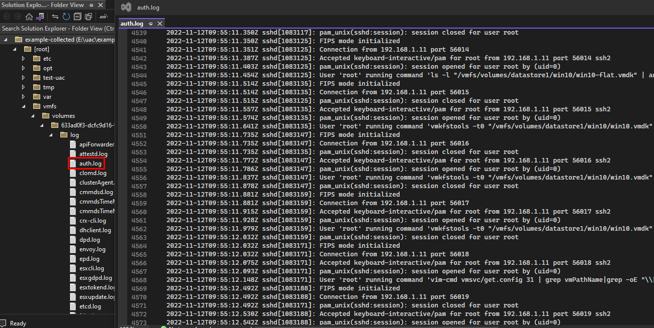
Auth.log
Bruteforce activity
User login
Create user backdoor ( in case machine compromised )

Slide 53
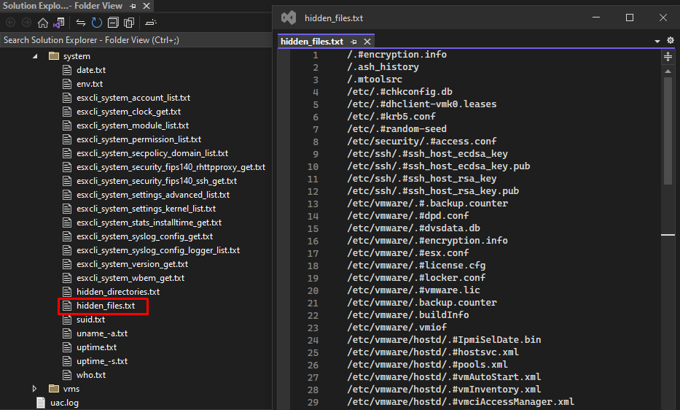
Hidden Files
Image, Doc, Executable file ( Include Malware )
Hidden Miners ( Cryptomining )

Slide 54

Activity Network Connection
Command & Control Communication
Running Process

Slide 55

Hash Executables ( MD5 )
Used for verification in platform Threat Intelligence

Slide 56

System Process List
Malicious Process

Slide 57
Lab : Analyzing Linux Bash History

Slide 58

Lab - Analyzing Linux Bash History
Please Explain line by line bash history shown below

Slide 59
Lab - Analyzing Linux Bash History
Writeup File will be uploaded in Gdrive :
Lab Writeup – Analyzing Linux Bash History.docx

Slide 60
Lab : Analyzing Linux Auditd Log

Slide 61
Lab - Analyzing Linux Auditd Log
Power on the Ubuntu VM Machine
Ensure the log file required for this lab is available.
Open Terminal
cd /home/sysadmin/Desktop/Artifacts/18.5\ -\ Auditd\ Logs/
ls –la
File Log : audit.log
Alternatively, you can download the log from Gdrive. Ask your instructor about the download links.

Slide 62
Lab - Analyzing Linux Auditd Log
Investigate auditd log file and find evidences of compromises
Answer all the questions to guide you find the evidences
Use any tools that you like to investigate
Some tools to consider:
Text Editor (Notepad++, Sublime, EmEditor, etc)
Command line in Linux grep, awk, sort, uniq
Log Analyzer 2 ( optional )
Petit Log Analysis Tools

Slide 63
Lab - Analyzing Linux Auditd Log
Questions :
What account is compromised?
What attack type was used to gain initial access?
What is the attacker's IP address?
What tool was used to perform system enumeration?
What is the name of the binary and pid used to gain root?
What CVE was exploited to gain root access? (Do your research!)
What type of vulnerability is this?
What file was exfiltrated once root was gained?

Slide 64
Lab - Analyzing Linux Auditd Log
Writeup File will be uploaded in Gdrive :
Lab 4 Writeup – Analyzing Linux Auditd Log.docx

Slide 65
Practical Lab : Windows DFIR Analysis

Slide 66
Hayabusa – Yamato Security
Sigma-based Threat Hunting and Fast Forensics Timeline Generator for Windows Event Logs.

Slide 67
Hayabusa – Overview
Cross-Platform support: Windows, Linux, MacOS
Easy to analyze Windows Event Logs
Supported by Sigma Rules for analysis
Free and open source
Project page: https://github.com/Yamato-Security/hayabusa

Slide 68
Hayabusa – Features
Cross-Platform support: Windows, Linux, MacOS
MITRE ATT&CK mapping of tactics.
Sigma rule support to convert sigma rules to Hayabusa rules.
Successful and failed logon summary.
Daily Sigma rule updates.
Etc.
For more information about Hayabusa:
https://github.com/Yamato-Security/hayabusa

Slide 69

Hayabusa – How to Use
Download on the Github Link
Choose according to the platform used
Extract the file in the folder provided
For more information about Hayabusa:
https://github.com/Yamato-Security/hayabusa

Slide 70
Hayabusa – Yamato Security
Study Case – Analyze Windows Event Logs

Slide 71

Hayabusa – Startup
Initial display when using Hayabusa. There is a command menu to run the tools.

Slide 72

Hayabusa – Command for Analyze Windows Event Logs
Hayabusa.exe csv-timeline –f “file event logs”
This command is used to analyze a Windows Event Logs

Slide 73

Hayabusa – Timeline Terminal Output

Slide 74

Hayabusa – Keyword Search Results

Slide 75

Hayabusa – Result Summary
This is the display of the results of the Windows Event Logs analysis.

Slide 76

Hayabusa – Command for Mass Analyze Windows Event Logs
Hayabusa.exe csv-timeline -d “folder event logs”
This command is used to analyze a Windows Event Log folders

Slide 77

Hayabusa – Result Summary
This is the display of the results of the Windows Event Logs analysis.

Slide 78

Hayabusa – Result Summary using Timeline Explorer
Hayabusa.exe csv-timeline -d “folder event logs” -o C:\Users\megio\OneDrive\Desktop\Tool\Hayabusa\output-csv\Credential-Access.csv

Slide 79

Hayabusa – Result Summary
This is the display of the results of the Windows Event Logs using Timeline Explorer.

Slide 80
Chainsaw – WithSecureLabs
Rapidly Search and Hunt through Windows Forensic Artefacts

Slide 81
Chainsaw – Overview
Cross-Platform support: Windows, Linux, MacOS
Easy to analyze Windows Event Logs
Supported by Sigma Rules for analysis
Free and open source
Project page: https://github.com/WithSecureLabs/chainsaw

Slide 82
Chainsaw – Features
Hunt for threats using Sigma detection rules and custom Chainsaw Detection rules.
Can be run on MacOS, Linux and Windows.
Create execution timelines by analysing Shimcache artefacts and enriching them with Amcache data.
Lightning fast, writing in rust, wrapping the EVTX Parser library.
Analyze the SRUM database and provide insights about it.
Etc.
For more information about Chainsaw:
https://github.com/WithSecureLabs/chainsaw

Slide 83

Chainsaw – How to Use
Download on the Github Link
Choose according to the platform used
Extract the file in the folder provided
For more information about Hayabusa:
https://github.com/WithSecureLabs/chainsaw/releases

Slide 84
Chainsaw – WithSecureLabs
Study Case – Analyze Windows Event Logs

Slide 85

Chainsaw – Startup
Initial display when using Chainsaw. There is a command menu to run the tools.

Slide 86

Chainsaw – Command for Analyze Windows Event Logs
chainsaw.exe hunt C:\Users\megio\OneDrive\Desktop\Tool\chainsaw\EVTX-ATTACK-SAMPLES -s sigma/ --mapping mappings/sigma-event-logs-all.yml -r rules/
This command is used to analyze the entire Windows Event Logs.

Slide 87

Chainsaw – Result Summary
This is the display of the results of the Windows Event Logs analysis.

Slide 88
Chainsaw – WithSecureLabs
Study Case – Analyze ShimCache

Slide 89

Chainsaw – Command for Analyze Shimcache Artifact
chainsaw.exe analyse shimcache C:\Users\megio\OneDrive\Desktop\Tool\chainsaw\samples\SYSTEM --regexfile C:\Users\megio\OneDrive\Desktop\Tool\chainsaw\analysis\shimcache_patterns.txt --amcache C:\Users\megio\OneDrive\Desktop\Tool\chainsaw\samples\Amcache.hve
This command is used to analyze the Shimcache artifact.

Slide 90

Chainsaw – Result Summary
This is the display of the results of the Shimcache analysis.

Slide 91
Thor Cloud Lite : On Demand Cloud Compromise Assessment Tools

Slide 92

Thor Cloud Lite
Free IOC and YARA Scanner
Lightweight Deployment
Centralized Cloud Management
No On-Premises Server or Agents
Custom IOC and YARA Signature

Slide 93



Thor Cloud Lite
Create New Campaign at the dashboard
Fill the detail of the campaign
Download and run the launcher
Wait for the scan process finished

Slide 94


Thor Cloud Lite
Result will show up in the campaign page
You can check the details of the scan results by displaying the HTML report

Slide 95
THANK YOU

